Slide 1
E.Sivasubraamanian
Digital image processing
MCA-b sec
Image compression standard and
binary compressions standard

Slide 2
Introduction
Image compression is a type of data compression applied to digital images.
It is used to reduce their cost for storage or transmission.
Types of Compressions are:
Lossy image Compression
Lossless image compression

Slide 3
Image compression standards
International standards
Binary image compression standards
CCITT Group 3 standard(G3)
CCITT Group 4 standard(G4)
Continuous one image and video compression standards
JPEG
JPEG 2000
MPEG-1
MPEG-2
MPEG-4
ITU-T H.261
H.263

Slide 4
JPEG STANDARD
JPEG is an image compression standard which was developed by "Joint Photographic Experts Group".
In 1992, it was accepted as an international standard.
JPEG is a lossy image compression method.
JPEG compression uses the DCT (Discrete Cosine Transform) method for coding transformation.
It allows a tradeoff between storage size and the degree of compression can be adjusted.

Slide 5
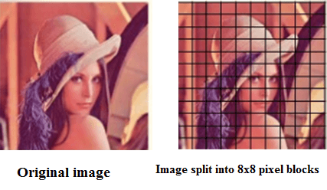
Following are the steps of JPEG Image Compression
Step 1: The input image is divided into a small block which is having 8x8 dimensions. This dimension is sum up to 64 units. Each unit of the image is called pixel.

Slide 6
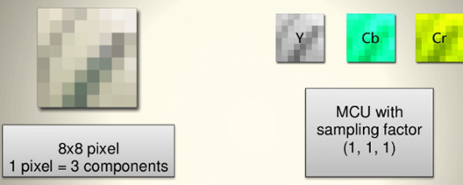
Step 2: JPEG uses [Y,Cb,Cr] model instead of using the [R,G,B] model. So in the 2nd step, RGB is converted into Y,Cb,Cr.

Slide 7
binary image compression
A binary image is one that consists of pixels that can have one of exactly two colors, usually black and white
Binary images are also called bi-level or two level, Pixelart made of two colours is often referred to as 1-Bit or 1bit.[2] This means that each pixel is stored as a single bit-i.e., a 0 or 1.
The names black-and-white, B&W, monochrome or monochromatic are often used for this concept, but may also designate any images that have only one sample per pixel, such as grayscale images.
In Photoshop parlance, a binary image is the same as an image in “Bitmap” mode.[3][4]

Slide 8
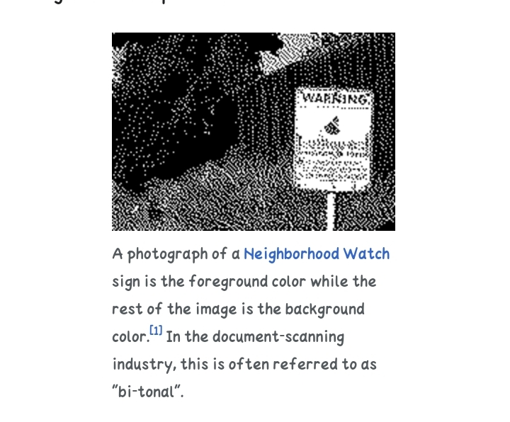
Example

Slide 9
Observation for binary compressions
Binary images often arise in digital image processing as masks or thresholding, and dithering. Some input/output devices, such as laser printers, fax machines, and bilevel computer displays, can only handle bilevel images.
A binary image can be stored in memory as a bitmap. A packed array of bits. A 640x480 image requires 37.5 KiB of storage.
Because of the small size of the image files, fax machine and document management solutions usually use this format. Most binary images also compress well with simple run-length compression schemes.
Binary images can be interpreted as subsets of the two-dimensional integer lattice Z2; the field of morphological image processing was largely inspired by this view.

Slide 10
THANK YOU…

